Slide 1
STRONG ROPES and SOFT RAGS
Jeremiah 38:7-13; 39:15-18

Slide 2
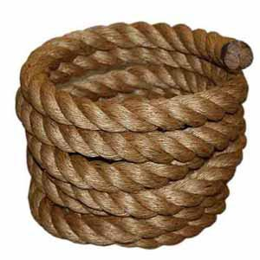
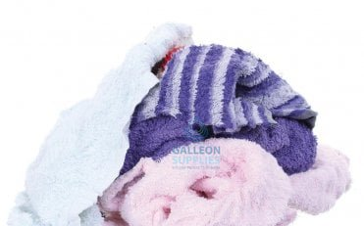
STRONG ROPE
& SOFT RAGS

Slide 3
EBED-MELECH RESCUES JEREMIAH
Jeremiah 38:7-13; 39:15-18

Slide 4
THE RISK HE TOOK
HIS COLOUR v.7
HIS COMPASSION v.8
THE CONFRONTATION

Slide 5
THE RESCUE THAT TOOK PLACE
AT THE KING’S COMMAND v10
AT EBED-MELECH’S INITIATIVE v11
NOTE EBED-MELECH’S CARE v12
NOTE EBED-MELECH’S CCOMPASSION v13

Slide 6
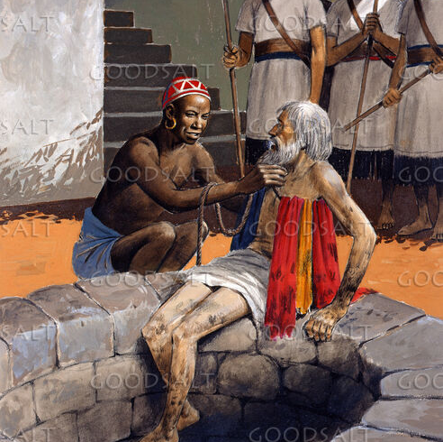
EBED-MELECH
RESCUES JEREMIAH

Slide 7
THE RELEASE OF GOD’S WORD
A KING’S QUESTION V14
JEREMIAH’S REQUEST v15
THE KING’S OATH v16
GOD’S WORD v17

Slide 8
THE REWARD
A WORD OF DISCIPLINE 39:15-16
A WORD OF DELIVERANCE 39:17-18

Slide 9
THE CHALLENGE
ACTS OF KINDNESS ARE MORE POWERFUL THAN WE REALISE
LET THIS FRUIT BE TASTED BY ALL WE MEET THIS WEEK
JOIN THE ALPHA TEAM or ….

