Slide 6
How can I keep on track?

Slide 10
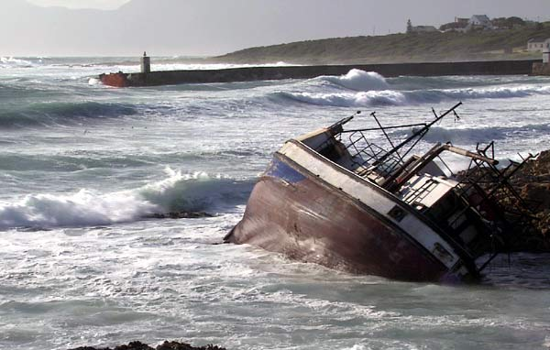
1 Timothy 1 v 19…..holding on to faith and a good conscience, which some have rejected and so have suffered shipwreck with regard to the faith.

Slide 12
Our dear friend Luke, the doctor, and Demas send greetings.
And so do Mark, Aristarchus, Demas and Luke, my fellow workers.
for Demas, because he loved this world, has deserted me and has gone to Thessalonica.

Slide 13
Galatians 1 v 1
I am astonished that you are so quickly deserting the one who called you to live in the grace of Christ and are turning to a different gospel— which is really no gospel at all
3 v 1
You foolish Galatians! Who has bewitched you?

Slide 14
What might cause me to derail?

Slide 15
Parable of the Sower – Matthew 13
Path | Birds ate seed | Evil one snatches word
Rocky Ground, not much soil | Grew quickly, no root, sun scorched | Receives word with joy. Fall away when trouble or persecution comes
Thorns | Thorns choked plants | Worries & deceitfulness of wealth choke the word – no fruit
Good soil | Good crop x100 x60 x30 | Hears word, understands it, produces a good crop

Slide 16
What might cause me to derail?
Being deceived. Our enemy is a master of deception. We may believe his lies
Wanting to do our own thing. Wanting independence from God.
Getting tired of serving God /pressure/disillusionment and doing His work in our strength
Worry
Gradually stop doing the basics- meeting together
reading God’s word
praying

Slide 17
What might cause me to derail?
Believing that the sin you have committed is too big.
The love of money
Persecution
Relationships
False beliefs/false teaching/false doctrine

Slide 18
So…. How do I stay on track?
Hebrews 12 (NKJV)
Therefore we also, since we are surrounded by so great a cloud of witnesses, let us lay aside every weight, and the sin which so easily ensnares us, and let us run with endurance the race that is set before us, looking unto Jesus, the author and finisher of our faith, who for the joy that was set before Him endured the cross, despising the shame, and has sat down at the right hand of the throne of God.

Slide 19
So…. How do I stay on track?
Negatively –
Lay aside every weight (hindrance)
Lay aside every sin –which so easily ensnares us

Slide 20
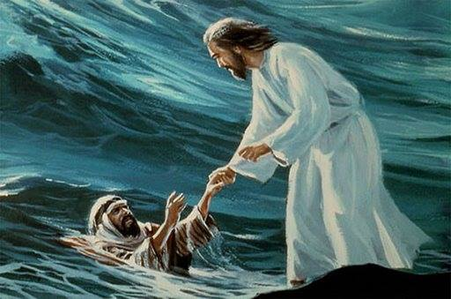
Positively-
Run the race with endurance
Keep your eyes on Jesus, the author and finisher of our faith

Slide 21
So…. How do I keep my eyes fixed on Jesus?
Gradually stop doing the basics- meeting together
reading God’s word
praying
Being deceived. Our enemy is a master of deception. We may believe his lies
Wanting to do our own thing. Wanting independence from God.
Getting tired of serving God /pressure/disillusionment and doing His work in our strength
Worry

Slide 22
Believing that the sin you have committed is too big.
The love of money
Persecution
Relationships
False beliefs/false teaching/false doctrine

Slide 23
Realise who you are. Your true identity
You are a sinner saved by grace
You have been born again
Therefore You are God’s Son/Daughter
You have a heavenly Father
You are the son/daughter of a King
God, The Holy Spirit lives in you

Slide 24
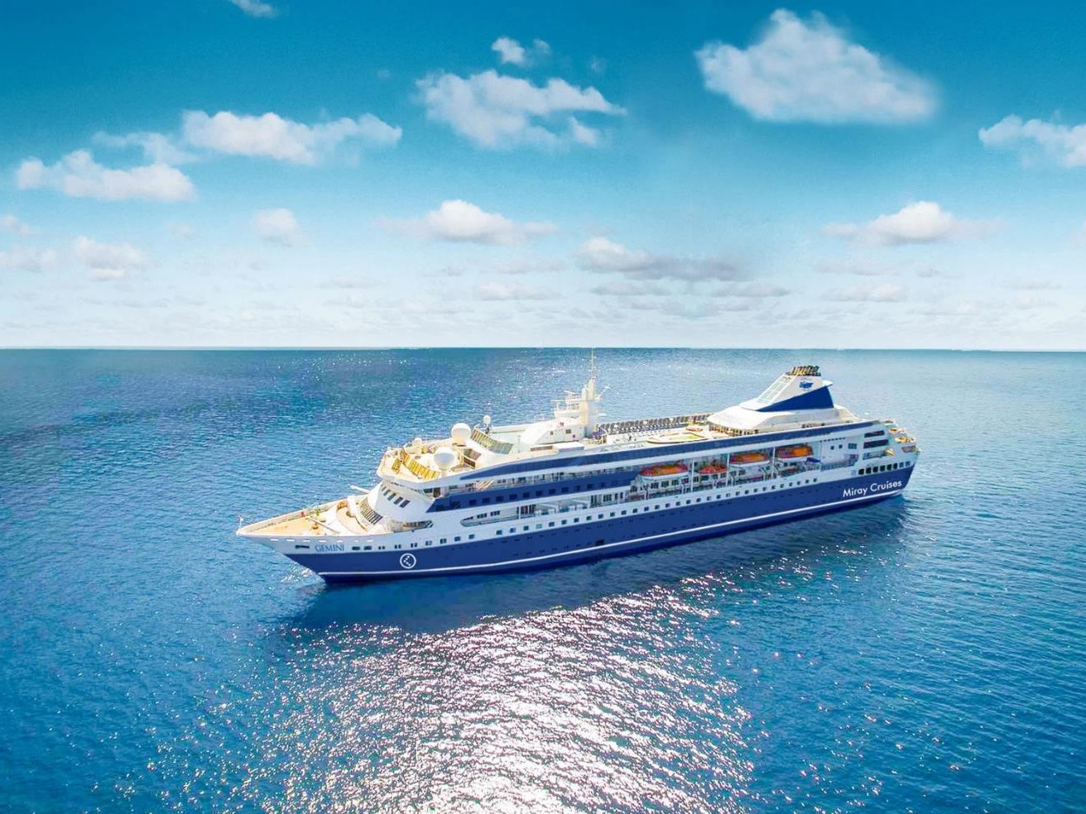
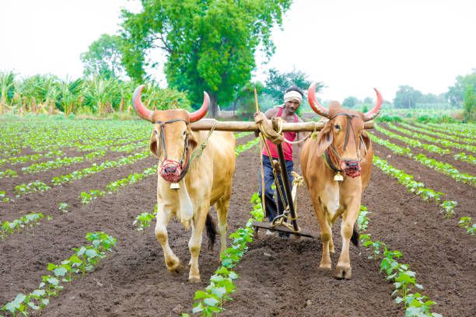
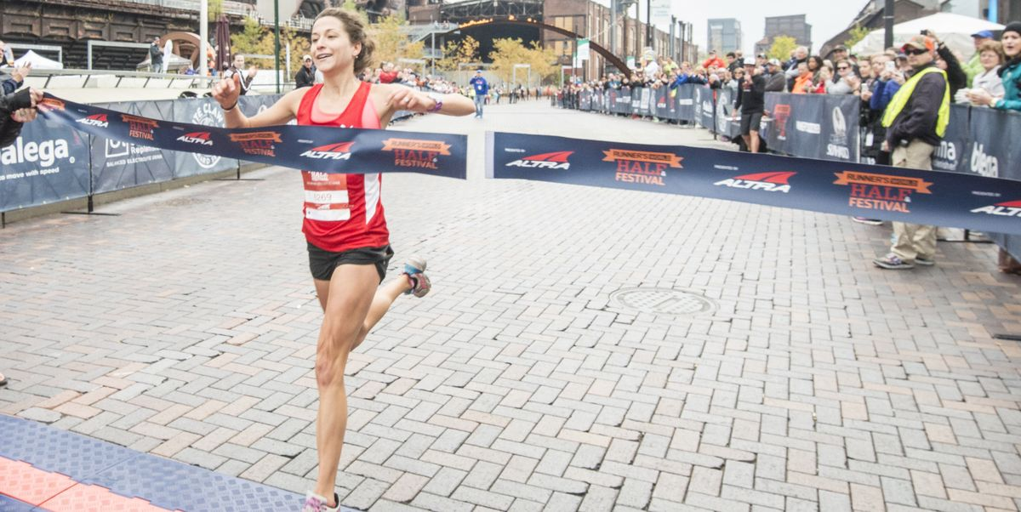
How can I keep on track?

