Slide 1
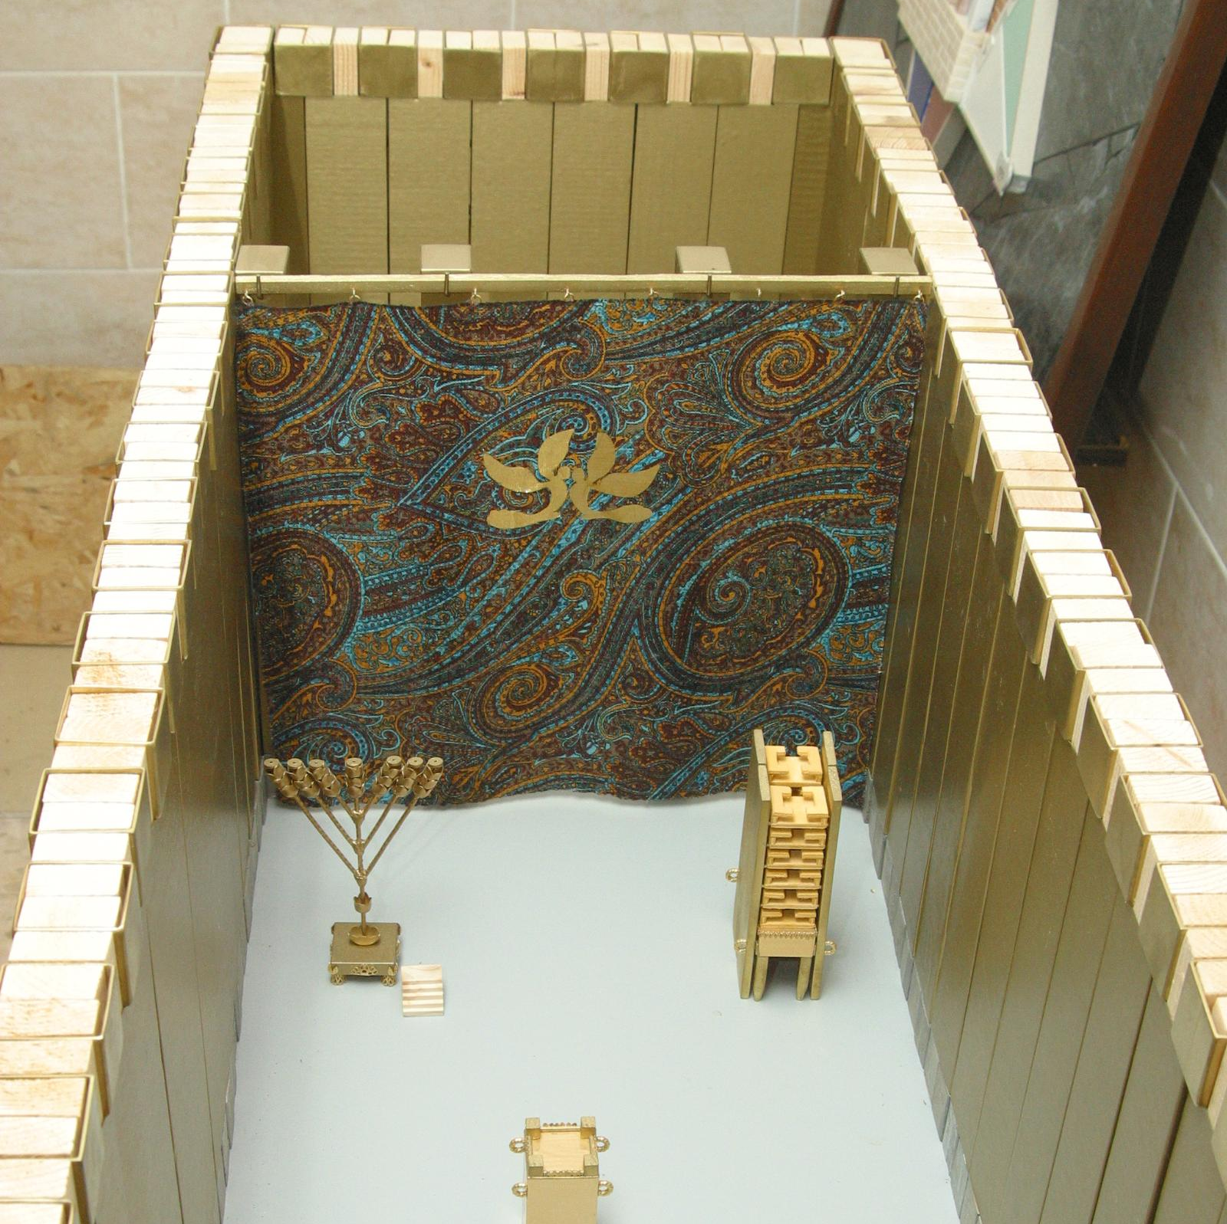
Picture of Holy of Holies

Slide 2
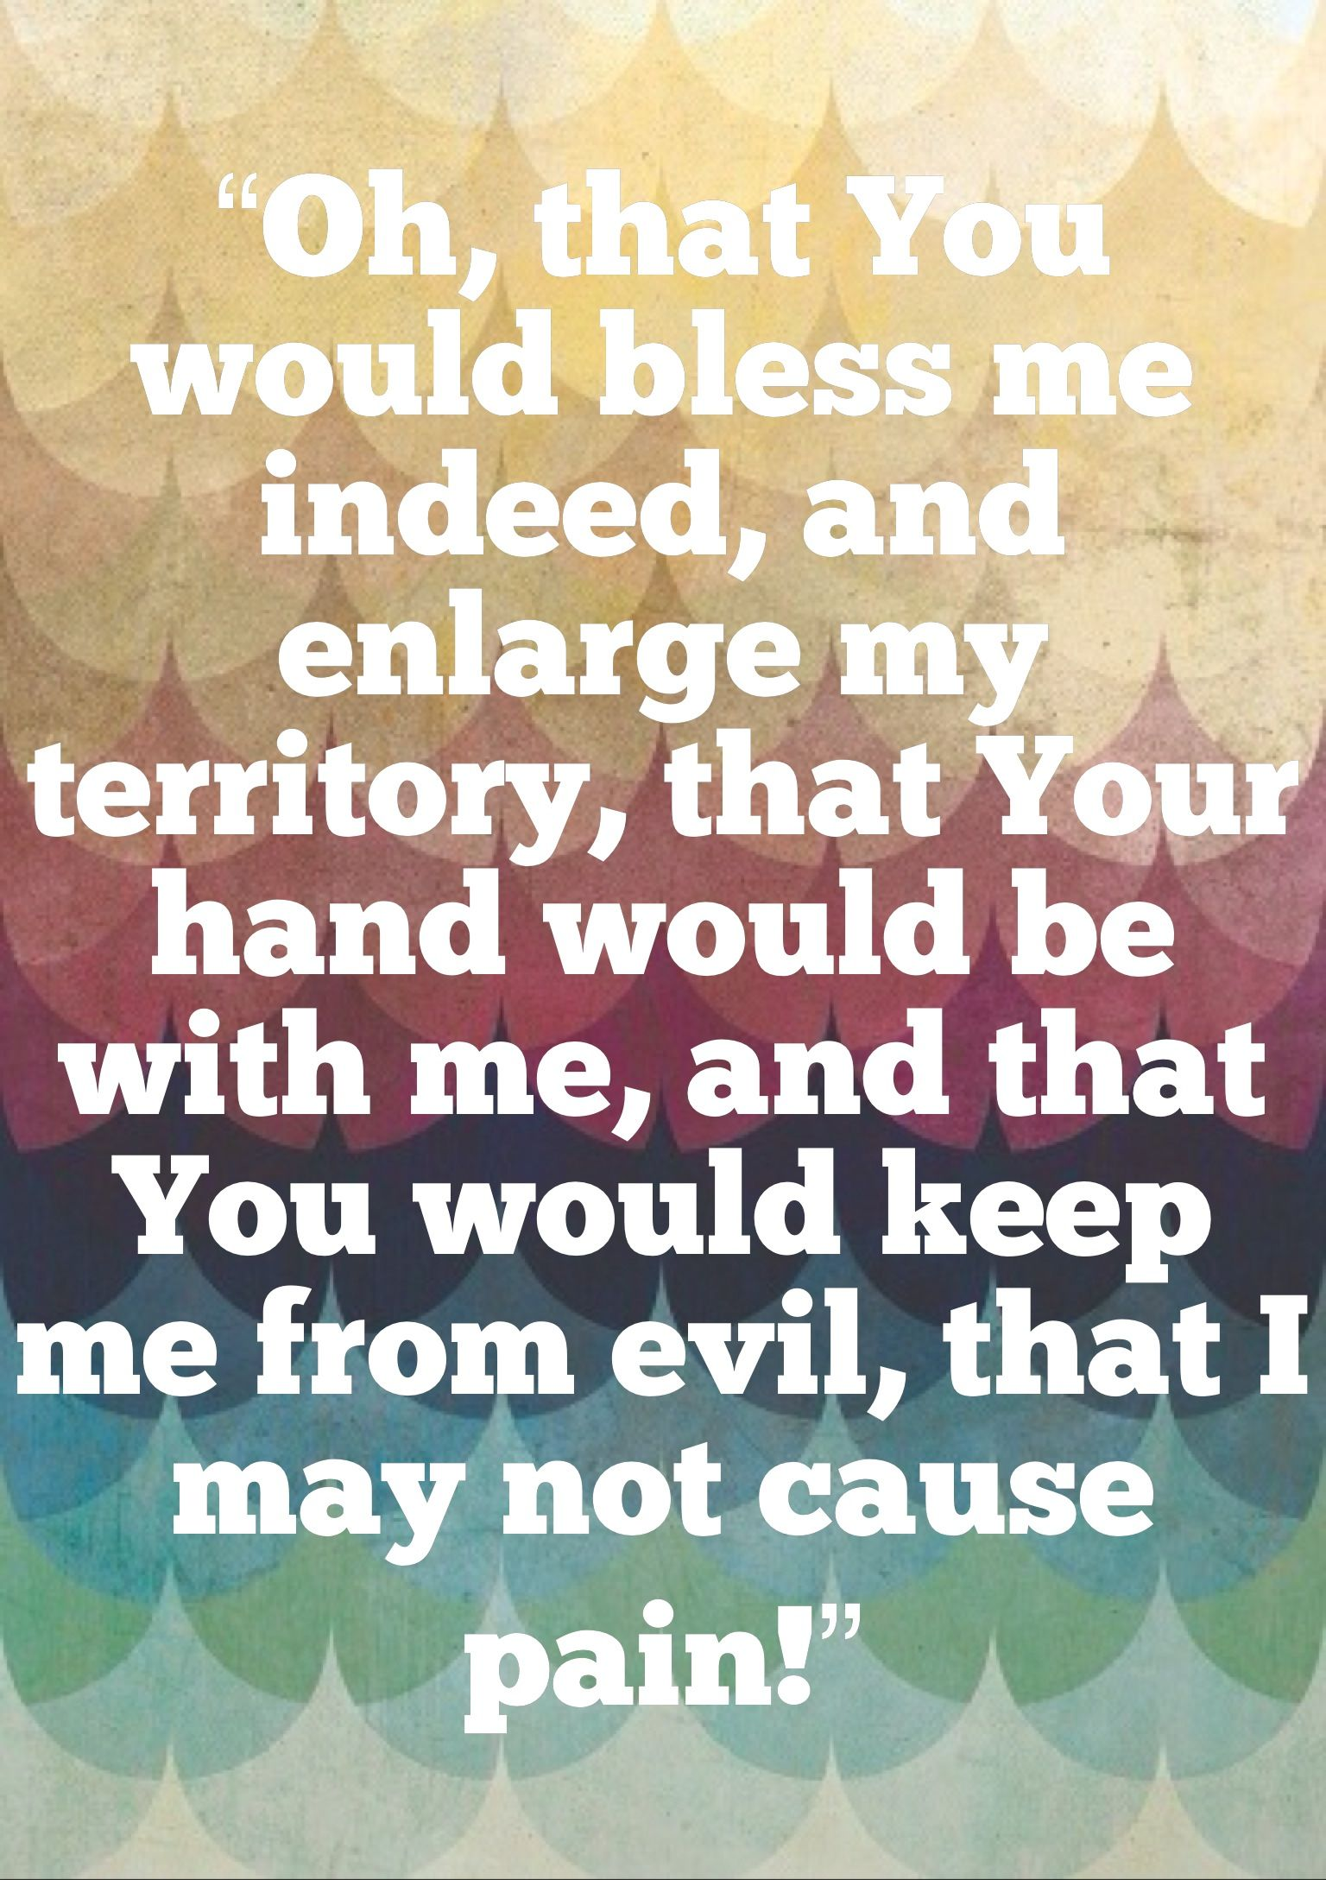
Prayer of Jabez 1Chron 4:10

Slide 5
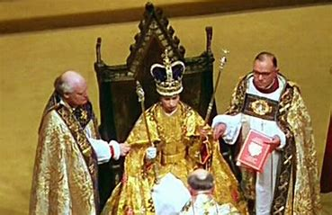
Coronation of Queen Elizabeth

Slide 6
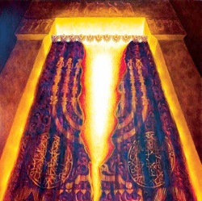
Picture of the curtain in the Temple

