Slide 1
“PAUL’S GOSPEL”
Romans 1:16

Slide 3
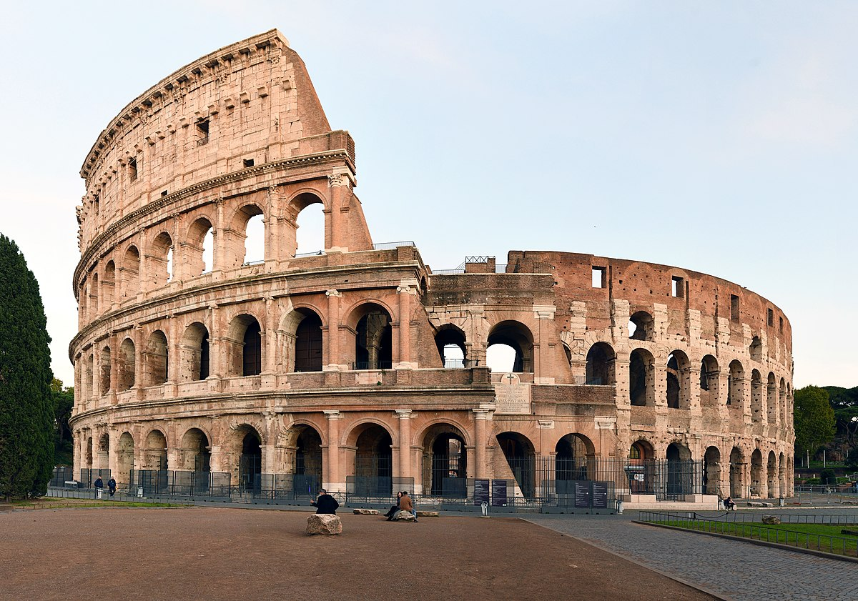

Slide 4
“Paul’s letter to Rome is the high peak of Scripture…All roads in the Bible lead to Romans & all views afforded by the Bible are seen most clearly from Romans.” J I Packer

Slide 5
The PREACHER of the GOSPEL
I am not ashamed of the gospel…”
“I am eager to preach the gospel to you also who are in Rome.”
Rom. 1:15

Slide 6
The POWER of the GOSPEL
“It is the power of God unto salvation”

Slide 7
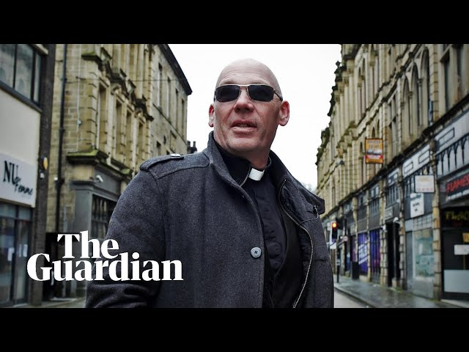

Slide 8
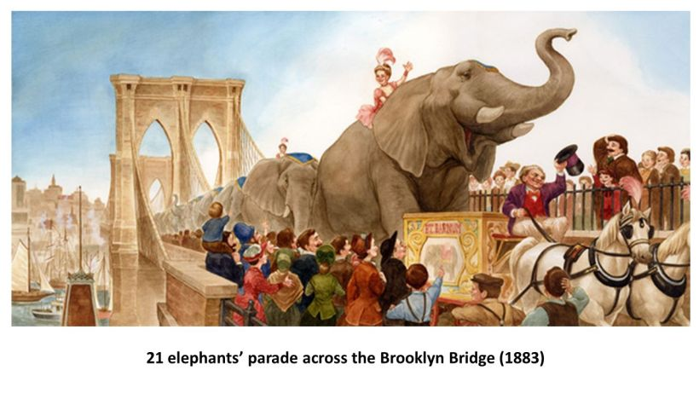

Slide 9
The PROCLAIMATION of the GOSPEL
“To the Jew first then to the Gentile” - “everyone else”
Victory of Jesus includes 3 LEVELS:
PERSONAL LEVEL (SALVATION)
RELATIONAL LEVEL (DIVISIONS HEALED)
COSMIC LEVEL (Romans 8)
“If we think that God’s power is restricted to the sphere of the spiritual, then we have a fairly small notion of God” Beverly Gavental

Slide 10
